Slide 1
OOPs in Python
OOPs in Python is a programming approach that focuses on using objects and classes as same as other general programming languages.
Python allows developers to develop applications using the OOPs approach with the major focus on code reusability.
It is very easy to create classes and objects in Python.

Slide 2
List of OOPs concepts
Class
Object
Method
Inheritance
Polymorphism
Encapsulation

Slide 3
Defining a Class in Python
What is a Class?
A class is a blueprint (template) used to create objects.
It defines variables (data) and functions (methods).
Attributes → Data/Properties
Methods → Functions/Behaviour
To create a class, use the “class” keyword followed by the class name.
The end of the Class name must declare a colon.
Basic Syntax
class ClassName:
def method(self):
# code
# Creating object
obj = ClassName()
class Student:
def display(self):
print("Welcome Student")
# object creation
s1 = Student()
# method call
s1.display()
What is self?
self refers to the current object
Used inside class methods to access variables

Slide 4
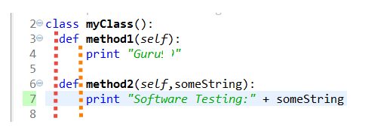
NOTE: About using "self" in Python
The self-argument refers to the object itself. Hence the use of the word self. So inside this method, self will refer to the specific instance of this object that's being operated on.
Self is the name preferred by convention by Pythons to indicate the first parameter of instance methods in Python. It is part of the Python syntax to access members of objects

Slide 5
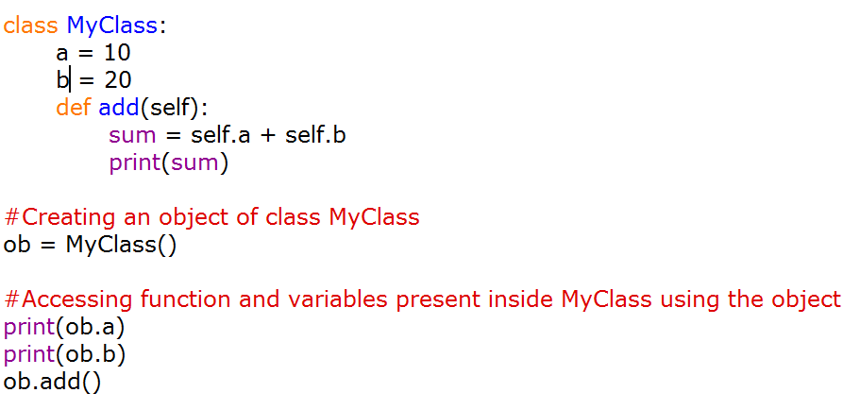
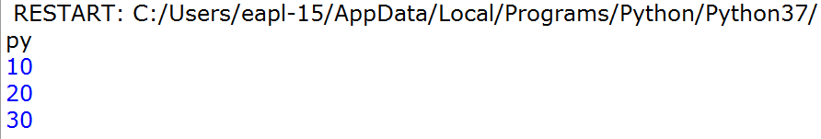
What is self?
self refers to the current object
Used inside class methods to access variables

Slide 6
class Student:
# Method
def display_details(self):
print("Name:", self.name)
print("Age:", self.age)
print("Marks:", self.marks)
# Creating Object
student1 = Student()
# Assigning values
student1.name = "Jaya"
student1.age = 20
student1.marks = 85.5
# Calling method
student1.display_details()
Output
Name: Jaya
Age: 20
Marks: 85.5

Slide 7
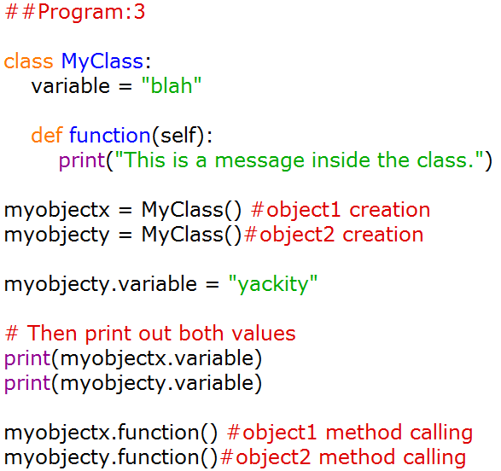
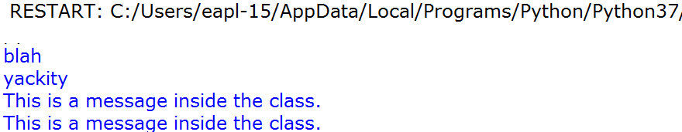

Slide 8
Python - Constructor
A constructor is a special kind of method which is used for initializing the instance variables during object creation.
constructor always has a name init and the name init is prefixed and suffixed with a double underscore(_ _).
declare a constructor using def keyword, just like methods.
Syntax of constructor declaration
def _ _init_ _(self):
# body of the constructor
Types of constructors in Python
We have two types of constructors in Python.
1. default constructor – This constructor doesn’t accept any arguments.
2. parameterized constructor – constructor with parameters is known as parameterized constructor.
https://beginnersbook.com/2018/03/python-constructors-default-and-parameterized/

Slide 9
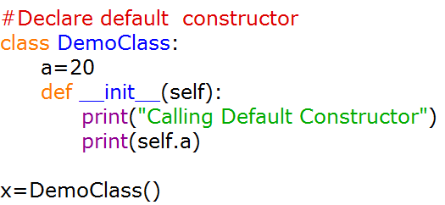
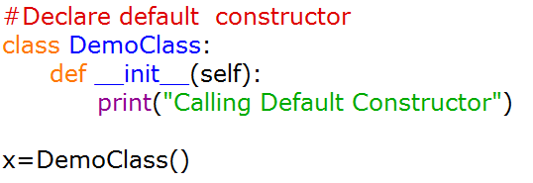

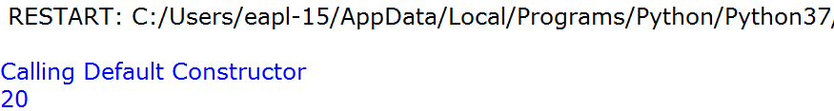
The __init__() Function
All classes have a function called __init__(), which is always executed when the class is being initiated.
Use the __init__() function to assign values to object properties, or other operations
Note: The __init__() function is called automatically every time the class is being used to create a new object.

Slide 10
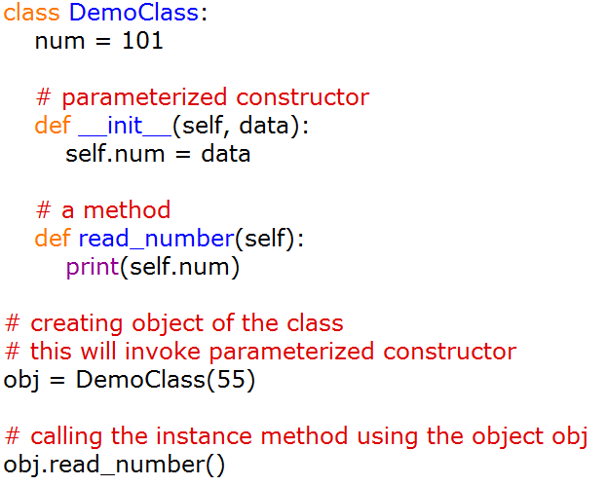
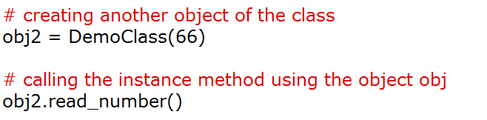
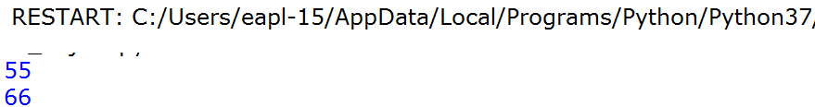
Python – Parameterized constructor
accepts the arguments during object creation then such type of constructors are known as Parameterized constructors.

Slide 11
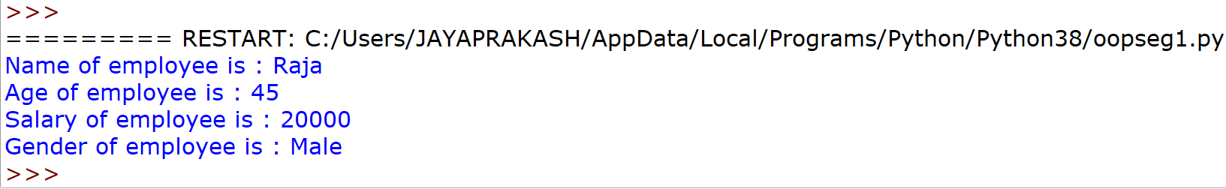
class Employee:
def __init__(self, name, age, salary, gender):
self.name = name
self.age = age
self.salary = salary
self.gender = gender
def employee_details(self):
print("Name of employee is :", self.name)
print("Age of employee is :", self.age)
print("Salary of employee is :", self.salary)
print("Gender of employee is :", self.gender)
emp = Employee("Raja", 45, 20000, "Male")
emp.employee_details()

Slide 12
Problem Statement: Student Details Management System
Objective:
Write a Python program using Class and Object to create and display student details.
Parameterized Constructor
Requirements
Create a class named Student with the following attributes:
name
age
marks
The class should contain:
A __init__() constructor to initialize student details.
A method display_details() to display the student information.
Create two student objects and display their details.

Slide 13
Sample Input
  Student 1:
  Name: Jaya
  Age: 20
  Marks: 85.5
  Student 2:
  Name: Kavin
  Age: 21
  Marks: 90.0
Sample Output
  Student Details
  ---------------
  Name: Jaya
  Age: 20
  Marks: 85.5
  Student Details
  ---------------
  Name: Kavin
  Age: 21
  Marks: 90.0

Slide 14
Term | Meaning
class | Creates a class
Student | Class name
__init__() | Constructor
self | Refers to the current object
name, age, marks | Attributes
display_details() | Method
student1 | Object
student2 | Object

Slide 15
class Student:
def __init__(self, name, age, marks):
self.name = name
self.age = age
self.marks = marks
def display_details(self):
print("Name:", self.name)
print("Age:", self.age)
print("Marks:", self.marks)
# Creating Objects
student1 = Student("Jaya", 20, 85.5)
student2 = Student("Kavin", 21, 90.0)
student1.display_details()
print()
student2.display_details()

Slide 16
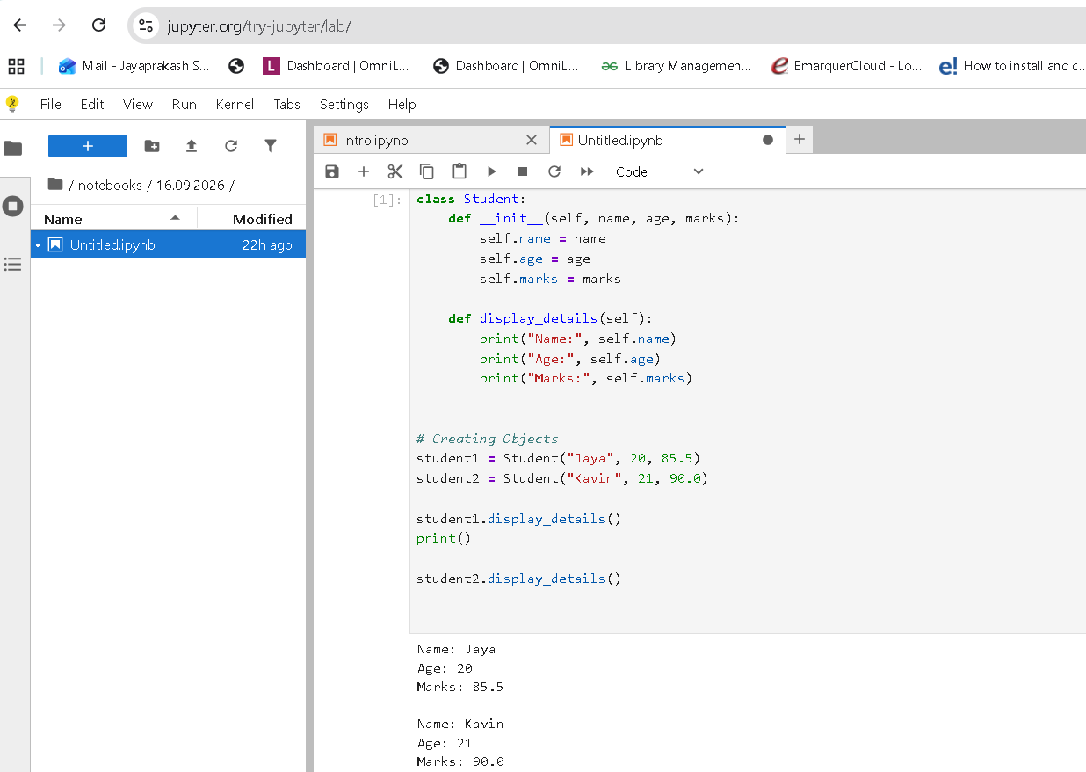

Slide 17
Problem Statement: Calculator Using Parameterized Constructor
Write a Python program to create a Calculator class using a parameterized constructor.
The program should:
Create a class named Calculations.
Define a parameterized constructor __init__(self, n1, n2) to initialize two numbers.
Create an addition() method to calculate the sum of the two numbers.
Create a subtraction() method to calculate the difference between the two numbers.
Create an object by passing two numbers to the constructor.
Call both methods and display the results.

Slide 18
Sample Input
Enter first number: 200
Enter second number: 100
Sample Output
Object Instantiated
Addition Working
Subtraction Working
Sum: 300
Difference: 100
Concepts Covered
Class → Object → Parameterized Constructor → __init__() → self → Instance Variables → Methods → Return Value

Slide 19
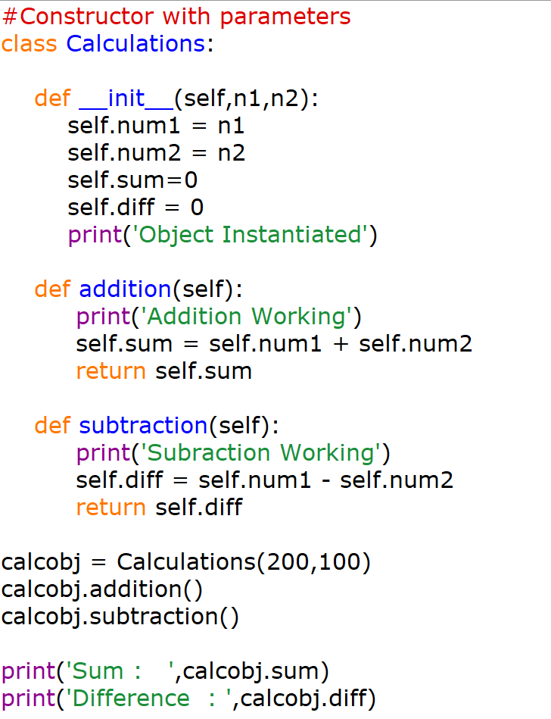
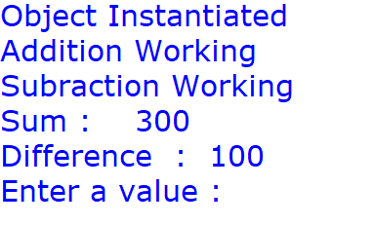

Slide 20
Python Destructors - Destroying the Object
Constructor is used to create and initialize an object, a destructor is used to destroy the object and perform the final clean up.
Although in python we do have garbage collector to clean up the memory, but its not just memory which has to be freed when an object is the buffer or cache etc. Hence when we say the final clean up, it doesn't only mean cleaning up the memory resources.
Using the __del__ method
Below we have a simple code for a class Example, where we have used the __init__ method to initialize our object, while we have defined the __del__ method to act as a destructor.

Slide 21
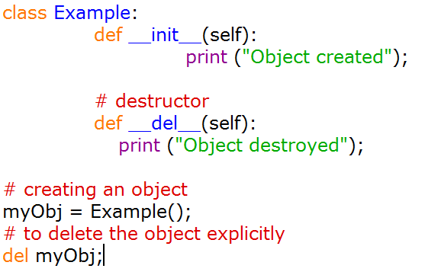
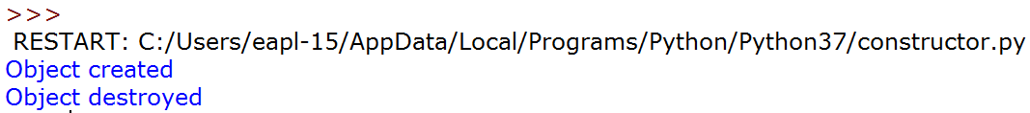
https://www.studytonight.com/python/inheritance-in-python

